Slide 1
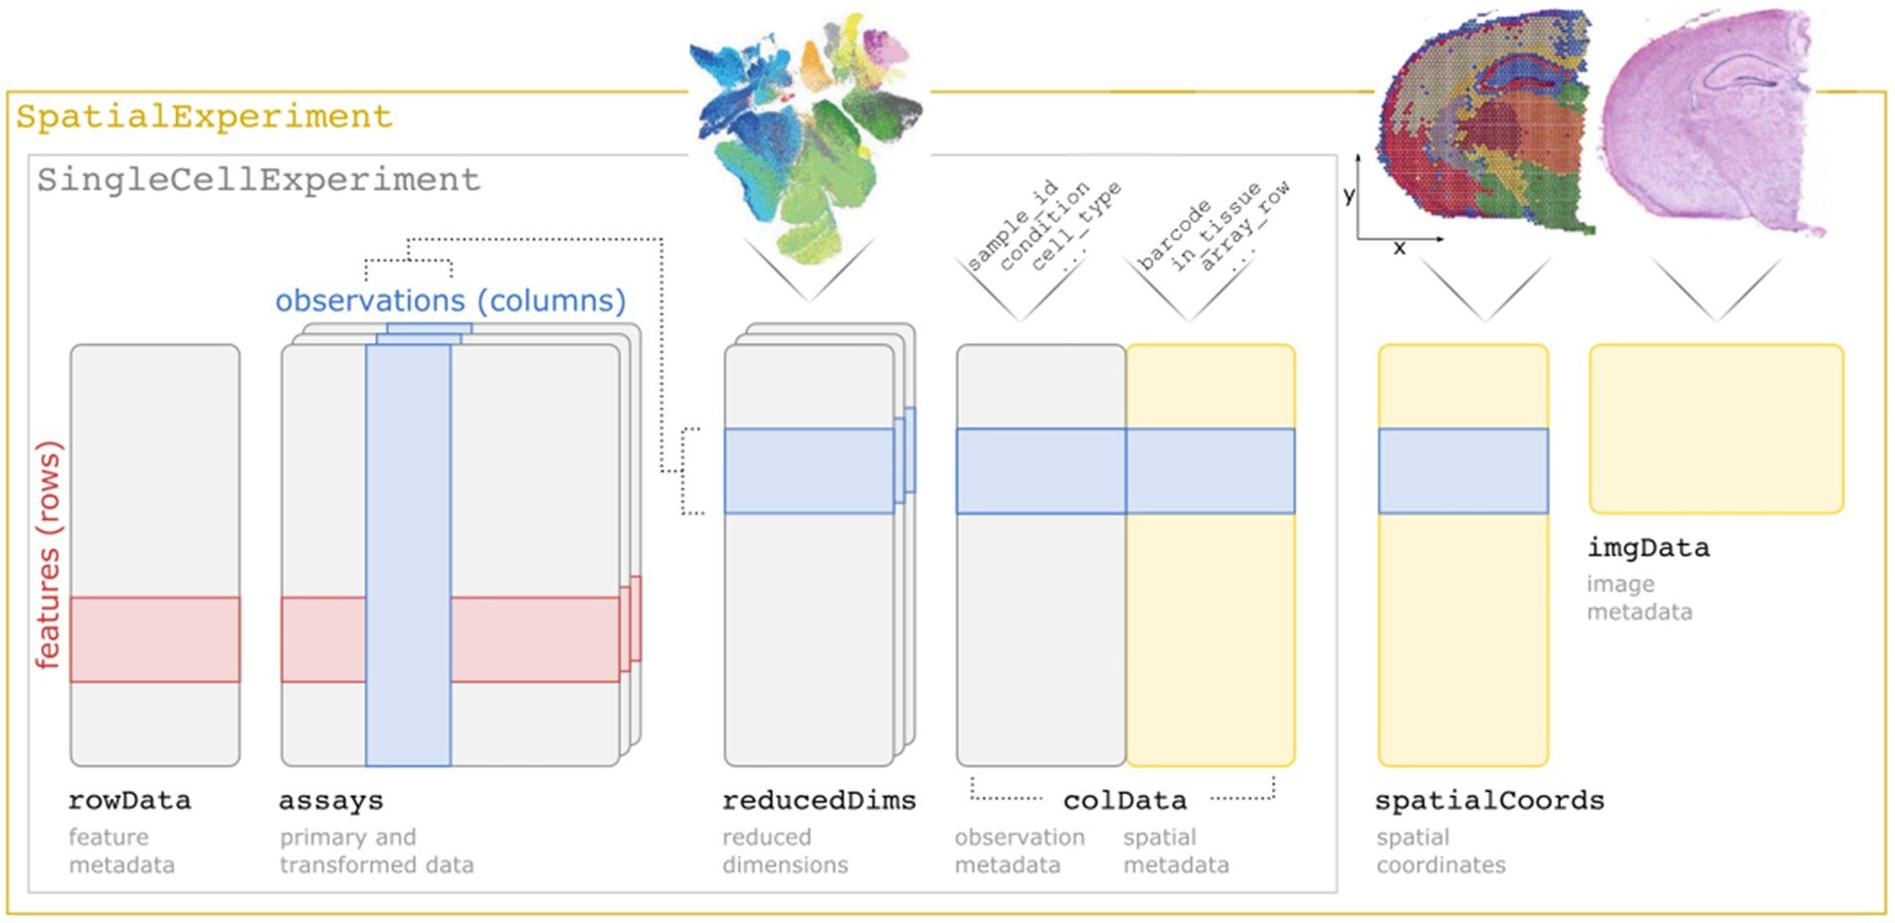

Fig. 1. Overview of the SpatialExperiment class structure, including assays (tables of measurement values), rowData ...
Notes:
Fig. 1. Overview of the SpatialExperiment class structure, including assays (tables of measurement values), rowData (metadata describing features), reducedDims (reduced dimension representations), colData (non-spatial and spatial metadata describing observations), spatialCoords (spatial coordinates associated with the observations) and imgData (image files and information)
Unless provided in the caption above, the following copyright applies to the content of this slide: © The Author(s) 2022. Published by Oxford University Press.This is an Open Access article distributed under the terms of the Creative Commons Attribution License (https://creativecommons.org/licenses/by/4.0/), which permits unrestricted reuse, distribution, and reproduction in any medium, provided the original work is properly cited.

